Slide 1
HTGB & HTRB Life TEST
FBG10N30

Slide 2
DC LIFE TEST
Tested variations of VDS and VGS voltages over several temperatures over a 2000Hrs timeframe
  VDS Tested : 110V, 120V, 130V at Temperatures of 90C and 120C
  VGS Tested : 5V, 6V, 6.75V at Temperatures of 110C and 150C
  Parts tested with full parametric test on Focused tester at interim steps 24hrs, 48,hrs, 96hrs, 210hrs, 500hrs, 1000hrs, 1500hrs, 2000hrs
  Parts with very high leakage were removed at each step
  X axis (voltage represents Applied stress voltage not test voltage)

Slide 3
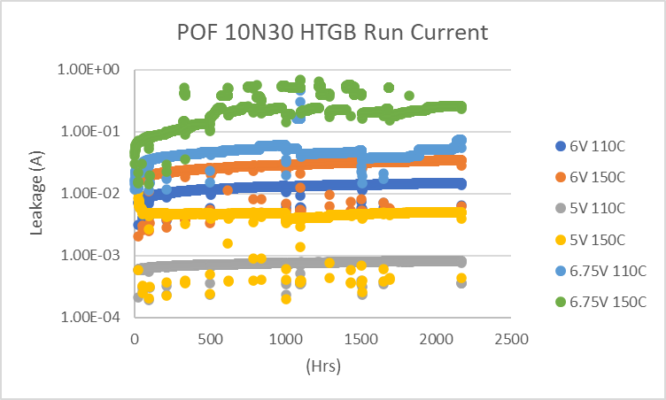
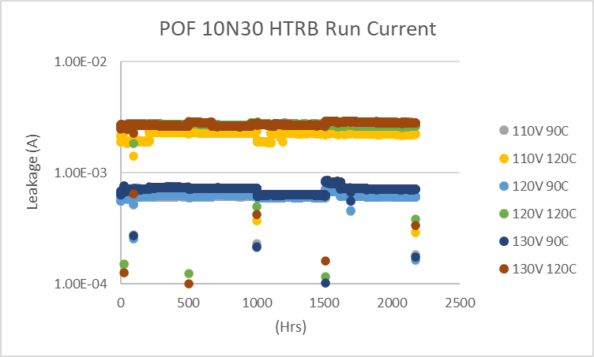
OVEN LOGS

Slide 4
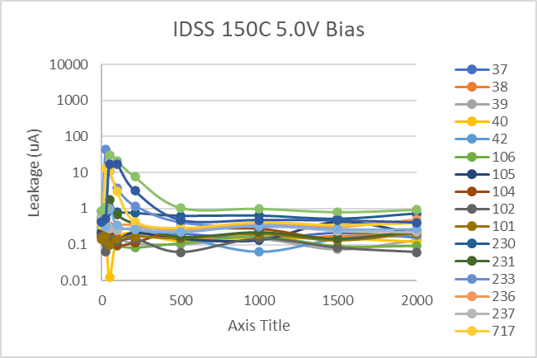
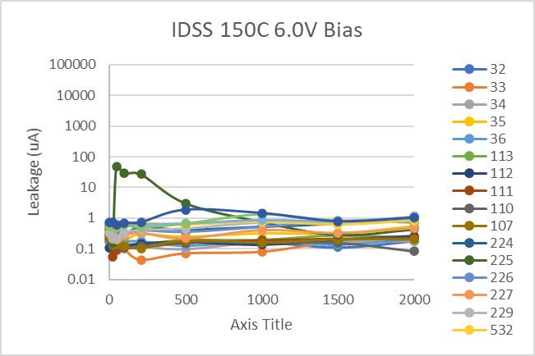
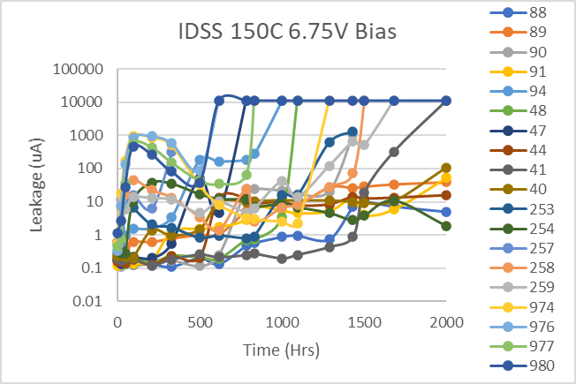
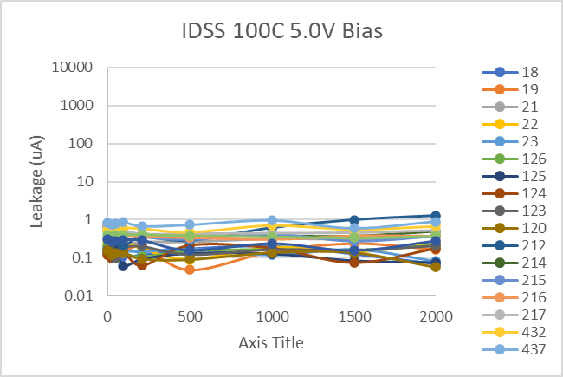
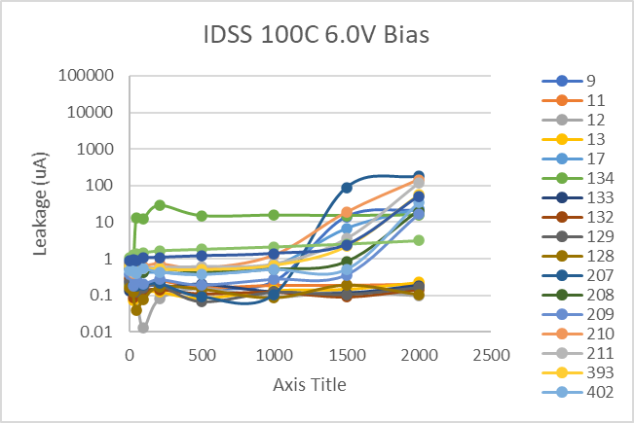
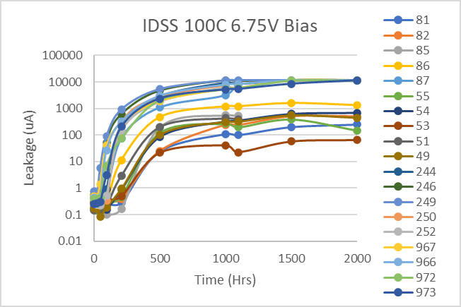
HTGB LIFE

Slide 5
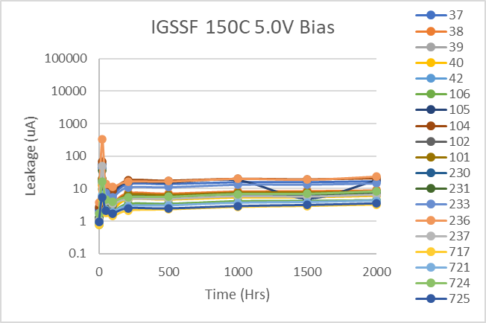
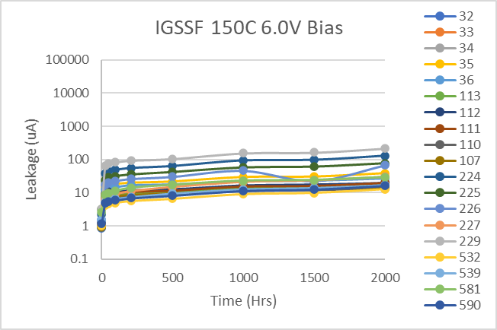
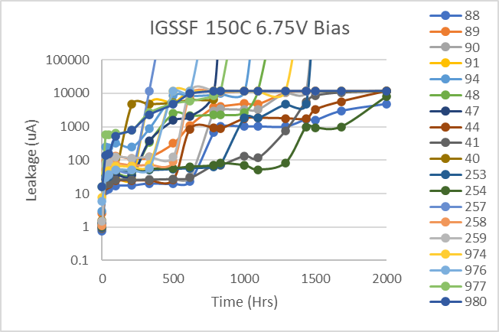
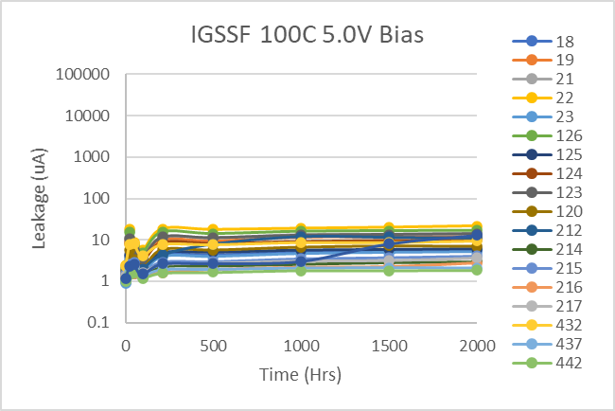
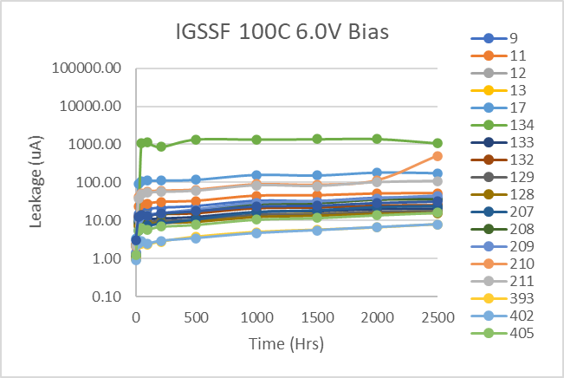
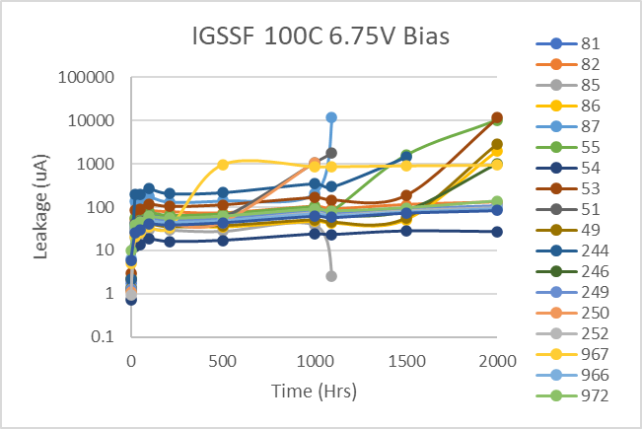
HTGB LIFE

Slide 6
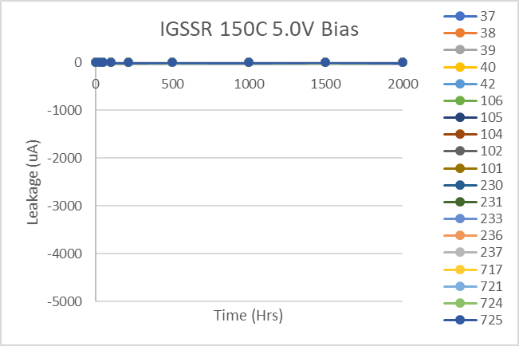
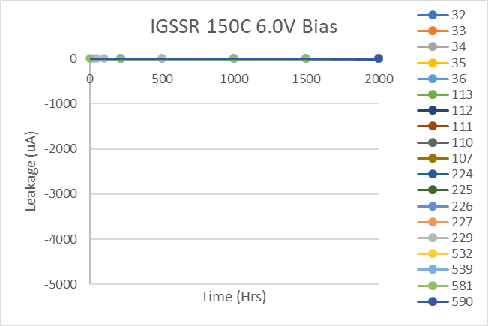
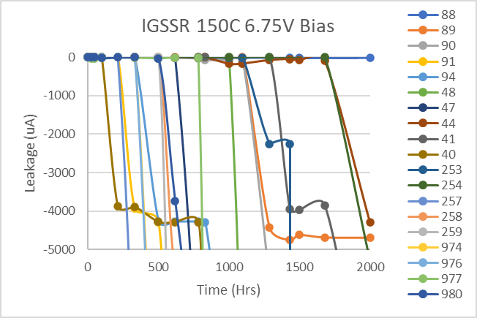
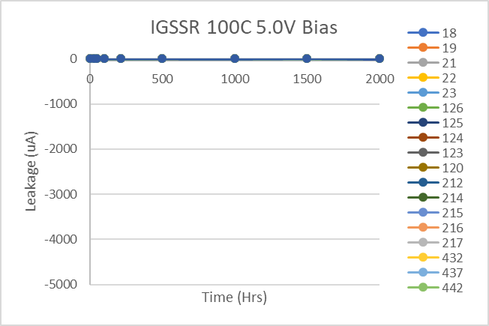
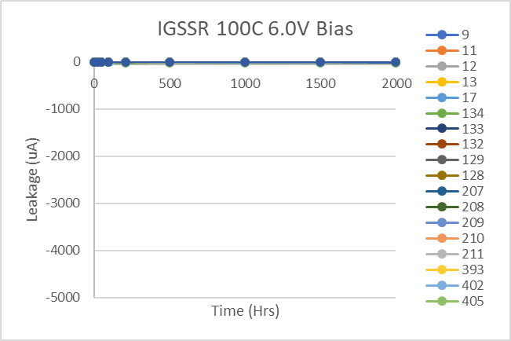
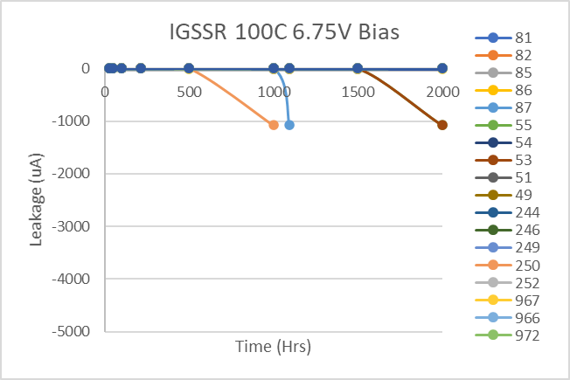
HTGB

Slide 7
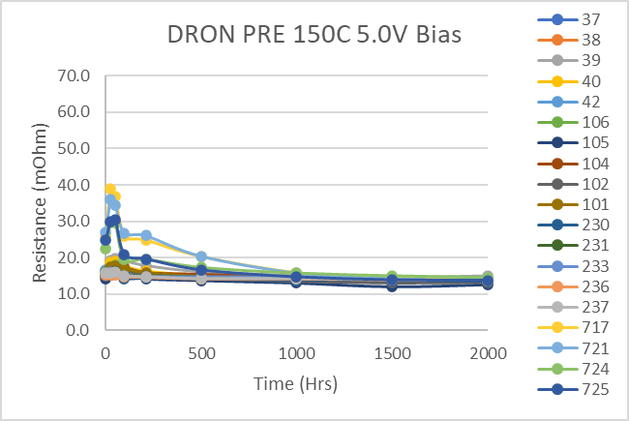
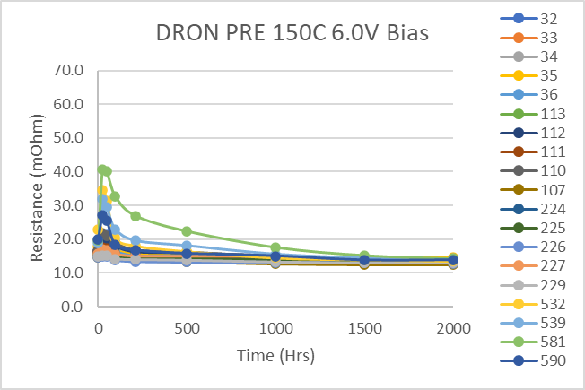
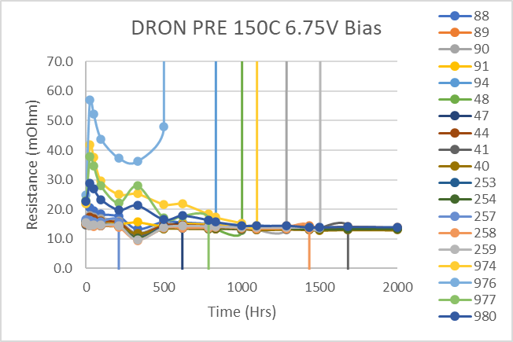
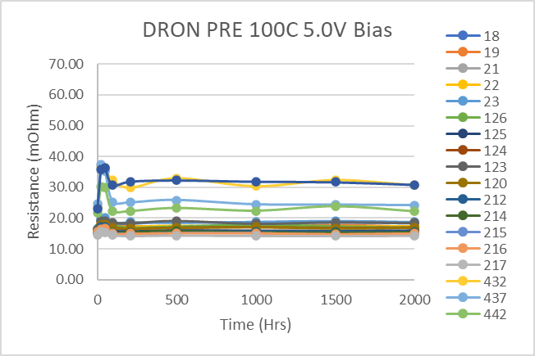
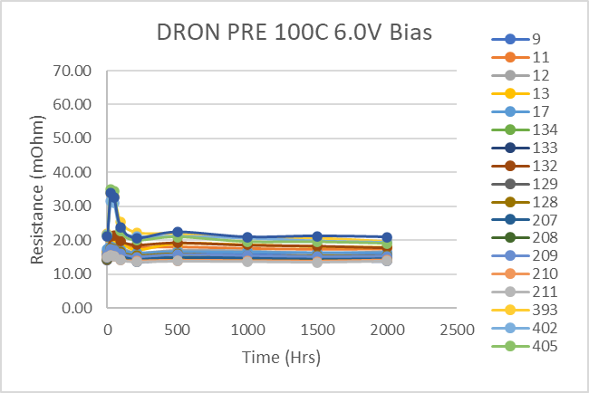
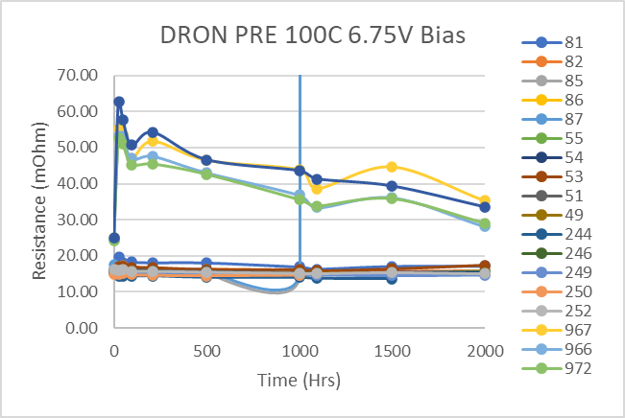
HTGB

Slide 8
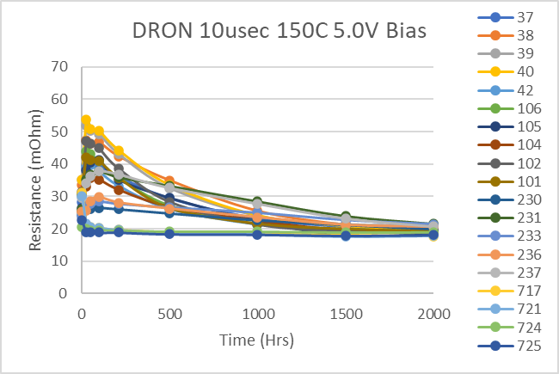
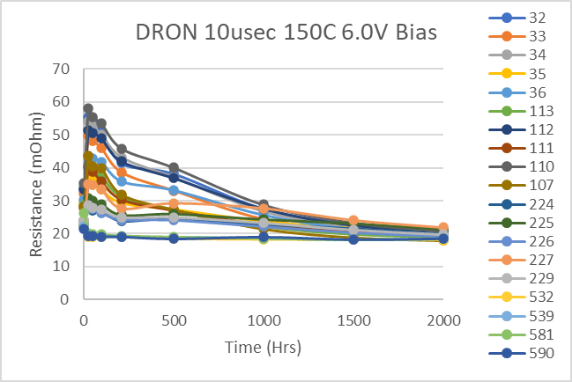
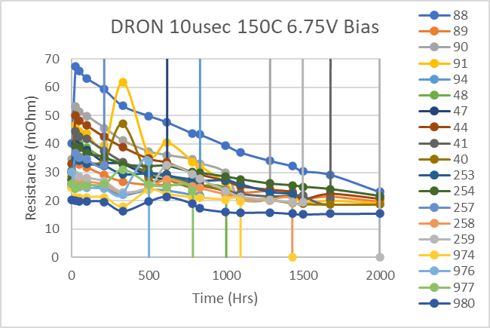
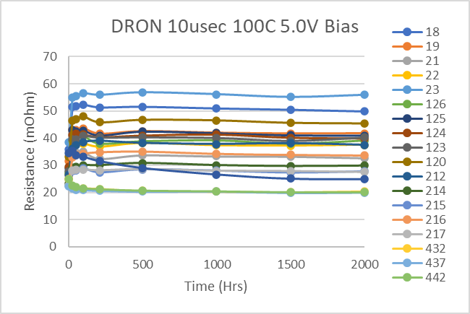
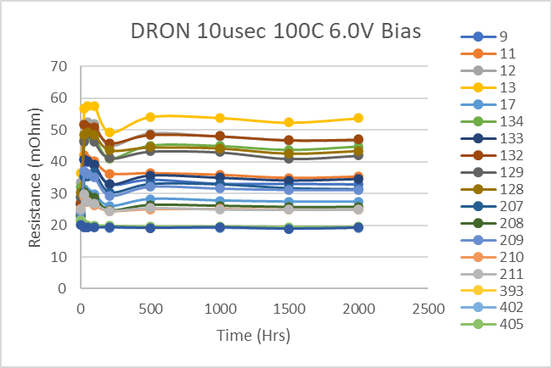
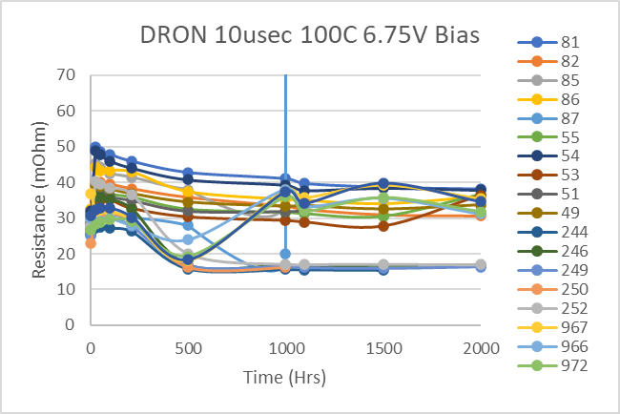
HTGB

Slide 9
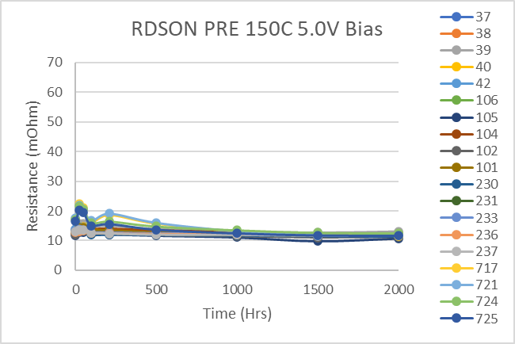
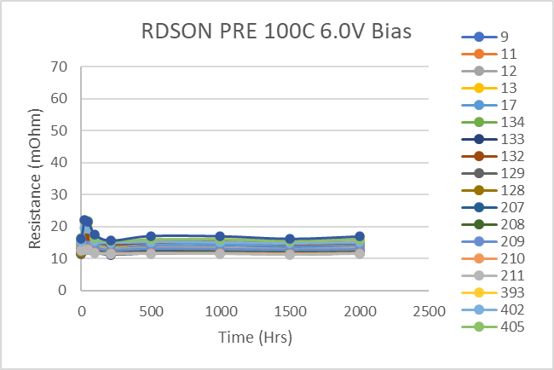
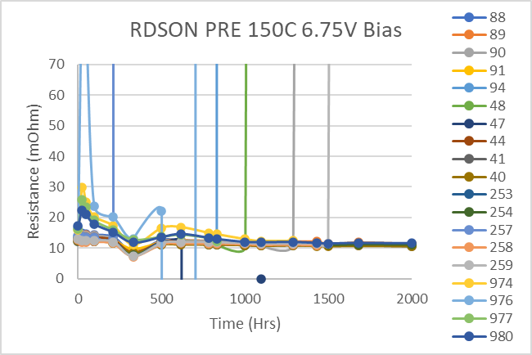
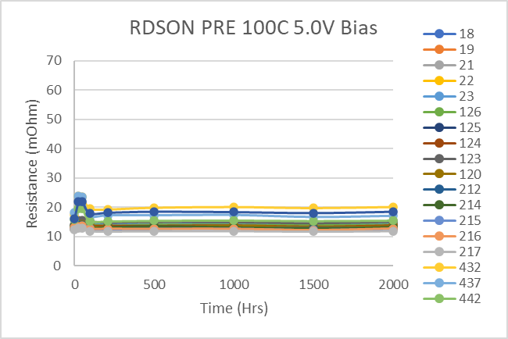
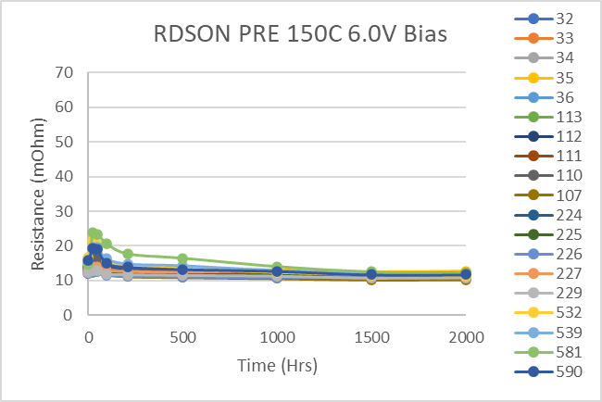
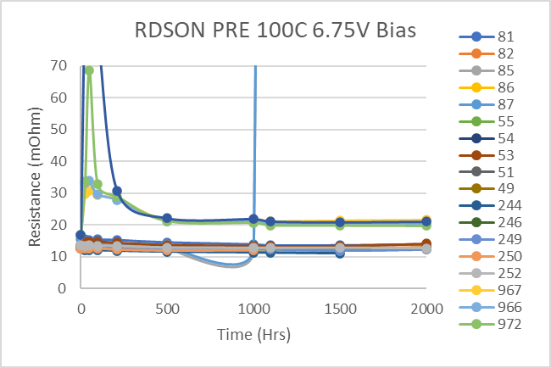
HTGB

Slide 10
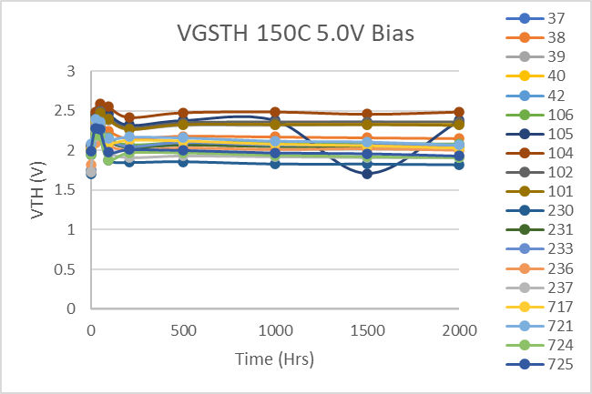
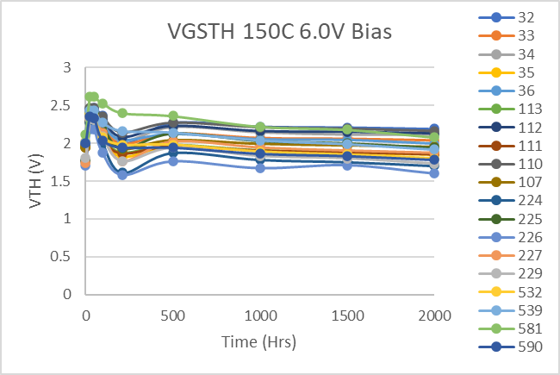
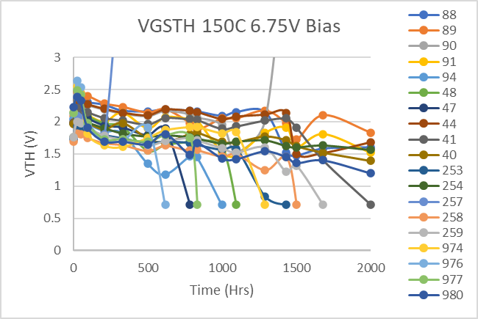
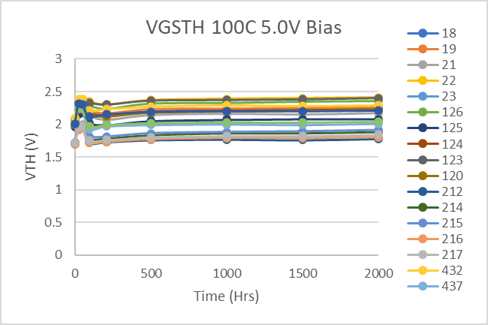
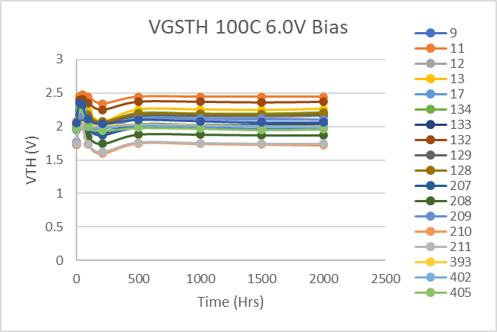
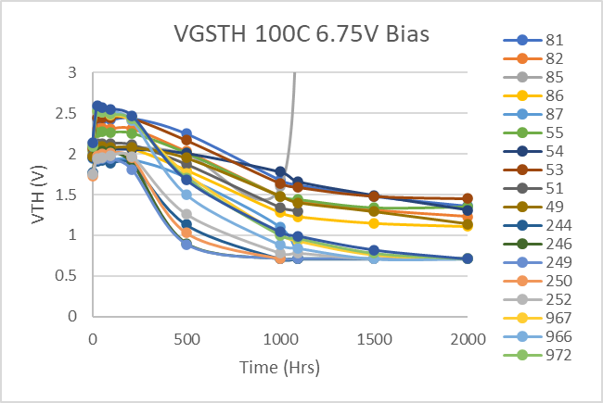
HTGB

Slide 11
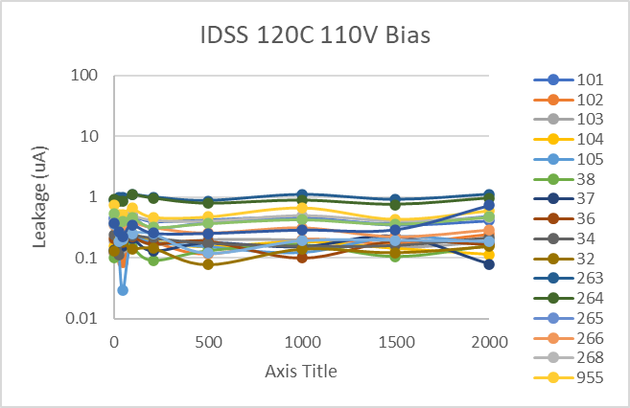
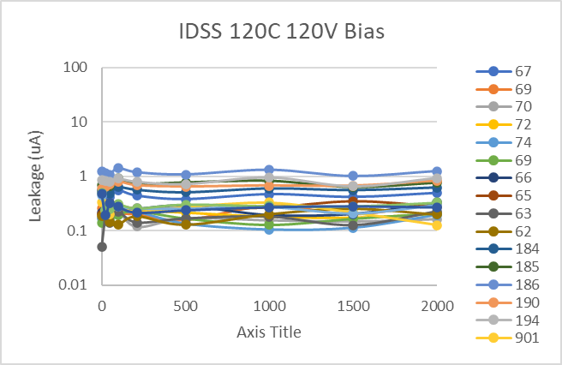
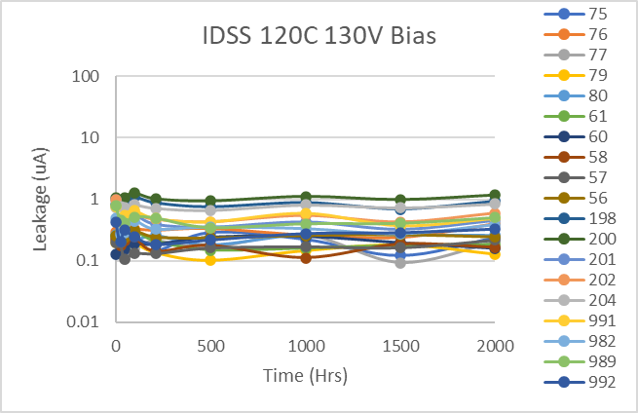
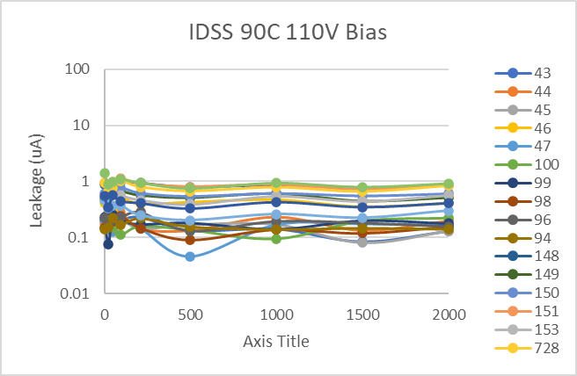
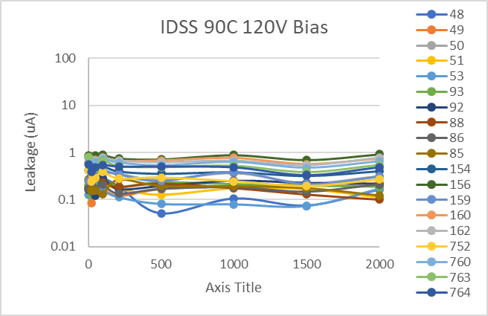
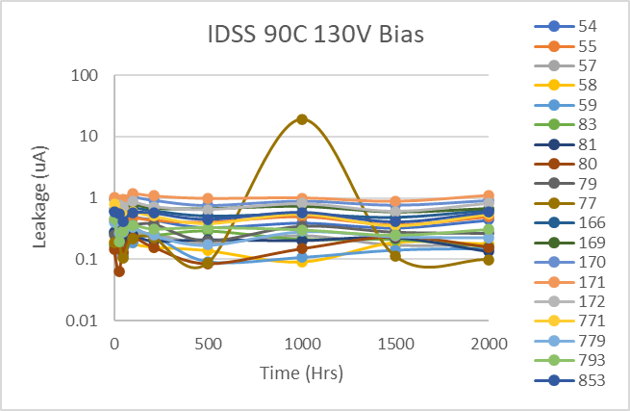
HTRB

Slide 12






HTRB

Slide 13






HTRB

Slide 14






HTRB

Slide 15






HTRB

Slide 16






HTRB

Slide 17






HTRB

Slide 18
LIFE TEST SUMMARY HTGB
Temp | Stress V | Time(Hrs) | SN | Wafer # | Notes
100C | 5V
 | 6V
 | 6.75 | 210 | 246 | B010-Mix | High Idss functional 2k
 |  |  | 249 | B010-Mix | High Idss functional 2k
 |  | 500 | 244 | B010-Mix | High Idss functional 1.5k
 |  |  | 250 | B010-Mix | High Idss functional 1k
 |  |  | 252 | B010-Mix | High Idss functional 2k
 |  |  | 967 | 1PB52 | High Idss functional 2k
 |  |  | 966 | 1PB52 | High Idss functional 2k
 |  |  | 972 | 1PB52 | High Idss functional 2k
 |  |  | 973 | 1PB52 | High Idss functional 2k
 |  |  | 87 | WAG0 | High Idss functional 1.096k
 |  | 1000 | 85 | WAG0 | High Idss functional 1.096k
 |  |  | 86 | WAG0 | High Idss functional 2k
 |  | 1500 | 82 | WAG0 | High Idss functional 2k
 |  |  | 54 | WAC7 | High Idss functional 2k
 |  |  | 49 | WAC7 | High Idss functional 2k
Temp | Stress V | Time(Hrs) | SN | Wafer # | Notes
150C | 5V
 | 6V |  |  |  | High IGSS pulled
 | 6.75 | 330 | 257 | B010-Mix | High IGSS functional 2K
 |  | 500 | 91 | WAG0 | High IGSS functional 1K
 |  |  | 94 | WAG0 | High IGSS functional 2K
 |  |  | 40 | WAC7 | High IGSS functional 1.288K
 |  |  | 974 | 1PB52 | High IGSS functional 618
 |  |  | 976 | 1PB52 | High IGSS functional 832
 |  |  | 977 | 1PB52 | High IGSS pulled
 |  | 784 | 47 | WAC7 | High IGSS pulled
 |  | 1096 | 48 | WAC7 | High IGSS functional 2K
 |  | 1288 | 89 | WAG0 | High IGSS functional 1.432K
 |  |  | 90 | WAG0 | High IGSS functional 2K
 |  | 1432 | 41 | WAC7 | High IGSS functional 2K
 |  | 1680 | 44 | WAC7 | High IGSS functional 2K
 |  | 2000 | 254 | B010-Mix

Slide 19
LIFE TEST SUMMARY HTRB
Temp | Stress V | Time(Hrs) | SN | Wafer # | Notes
90C | 110 | 2000 | N/A |  | No Hard failures
 | 120 | 2001 | N/A |  | No Hard failures
 | 130 | 2002 | N/A |  | No Hard failures
120C | 110 | 2003 | N/A |  | No Hard failures
 | 120 | 2004 | N/A |  | No Hard failures
 | 130 | 2005 | N/A |  | No Hard failures

